Slide 1
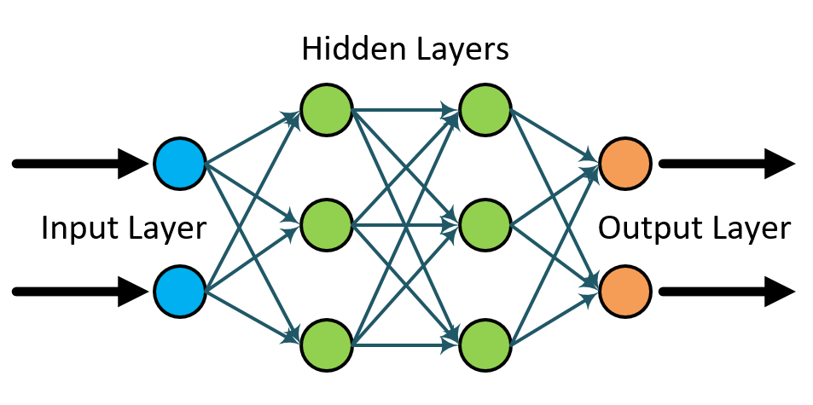
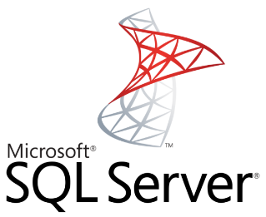


Data Science Virtual Machine – A Walkthrough of end-to-end Analytics Scenarios Barnam Bora Program Manager - Engineering

Slide 2
Agenda
Brief introduction to the Data Science Virtual Machines in Azure
Scenario Walkthroughs:
SQL Server R Services: - Dev>Train>Test>Deploy>Score
Using the Local Spark instance on the DSVM for Dev & Test
Training and Deploying Deep Learning Models Using the ‘Deep Learning Toolkit for the DSVM’ on GPU based Azure VMs
Briefly Querying and wrangling across platforms
Roadmap
Q and A + Conclusion
This session aims to familiarize attendees to some popular scenarios enabled by the DSVM and the included tools.
This is not a general training module for Data Science. Please visit http://learnanalytics.microsoft.com
Notes:
Cortana Intelligence delivers an end-to-end platform with an integrated and comprehensive set of tools and services to help you build intelligent applications that let you easily take advantage of Advanced Analytics and intelligence capabilities.
First, Cortana Intelligence provides services to bring data in, so that you can analyze it. It provides information management capabilities like Azure Data Factory so that you can pull data from any source (relational DB like SQL or non-relational ones like your Hadoop cluster) in an automated and scheduled way, while performing the necessary data transforms (like setting certain data columns as dates vs. currency etc). Think ETL (Extract, Transform, Load) in the cloud. Event Hubs does the same for IoT type ingestion of data that streams in from lots of end points.
The data brought in then can be persisted in flexible big data storage services like Data Lake Store and Azure SQL Data Warehouse.
You can then use a wide range of analytics services from Machine Learning to Azure Data Lake Analytics to Azure HDInsight to Azure Stream Analytics to analyze the data stored in the big data storage. This means you can create analytics services and models specific to your business need (say real time demand forecasting).
The resultant analytics services and models created by taking these steps can then be surfaced as interactive dashboards and visualizations via Power BI.
These same analytics services and models created can also be integrated into various different UI (web apps or mobile apps or rich client apps), or with Cortana, so end users can naturally interact with them via speech etc., and so that end users can get proactively be notified by Cortana if the analytics model finds a new anomaly (unusual growth in certain product purchases- in the case of real time demand forecasting example given above) or whatever deserves the attention of the business users. Similar integration can occur with Cognitive Services or Bot Framework based applications.
At a high level though, Cortana Intelligence capabilities are in three main areas: data, analytics and intelligence.
<Transition>: We’re going to dive into each one, starting with data.

Slide 3
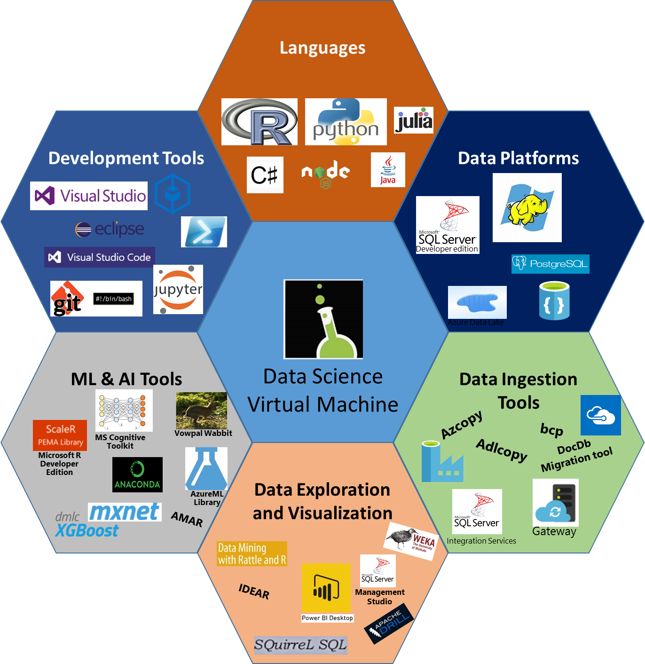


Data Science VM ?
Comprehensive cloud based Data Science Environment to empower Data Scientists
Notes:
Cortana Intelligence delivers an end-to-end platform with an integrated and comprehensive set of tools and services to help you build intelligent applications that let you easily take advantage of Advanced Analytics and intelligence capabilities.
First, Cortana Intelligence provides services to bring data in, so that you can analyze it. It provides information management capabilities like Azure Data Factory so that you can pull data from any source (relational DB like SQL or non-relational ones like your Hadoop cluster) in an automated and scheduled way, while performing the necessary data transforms (like setting certain data columns as dates vs. currency etc). Think ETL (Extract, Transform, Load) in the cloud. Event Hubs does the same for IoT type ingestion of data that streams in from lots of end points.
The data brought in then can be persisted in flexible big data storage services like Data Lake Store and Azure SQL Data Warehouse.
You can then use a wide range of analytics services from Machine Learning to Azure Data Lake Analytics to Azure HDInsight to Azure Stream Analytics to analyze the data stored in the big data storage. This means you can create analytics services and models specific to your business need (say real time demand forecasting).
The resultant analytics services and models created by taking these steps can then be surfaced as interactive dashboards and visualizations via Power BI.
These same analytics services and models created can also be integrated into various different UI (web apps or mobile apps or rich client apps), or with Cortana, so end users can naturally interact with them via speech etc., and so that end users can get proactively be notified by Cortana if the analytics model finds a new anomaly (unusual growth in certain product purchases- in the case of real time demand forecasting example given above) or whatever deserves the attention of the business users. Similar integration can occur with Cognitive Services or Bot Framework based applications.
At a high level though, Cortana Intelligence capabilities are in three main areas: data, analytics and intelligence.
<Transition>: We’re going to dive into each one, starting with data.

Slide 4
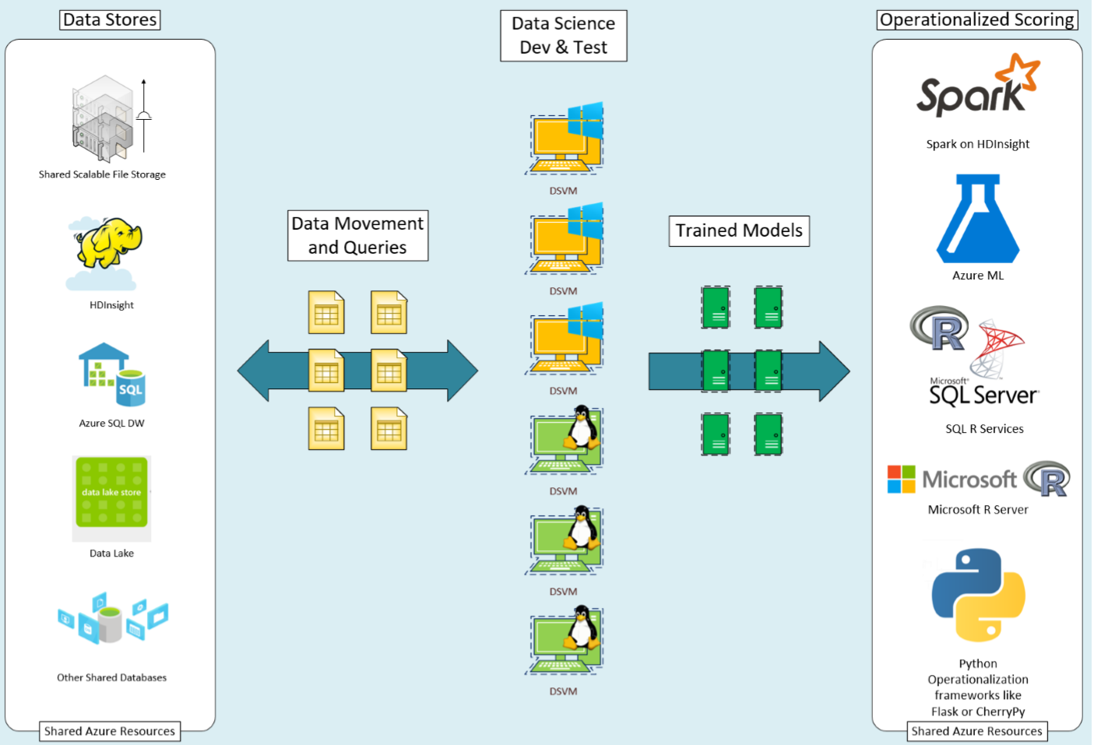
Development flow with DSVM

Slide 5
VM Versions comparison – Quick Reference
Windows Edition
Microsoft R Open with popular packages pre-installed
Microsoft R Server Developer Edition
Anaconda Python 2.7, 3.5
JuliaPro with popular packages pre-installed
Jupyter Notebook Server (R, Python, Julia)
SQL Server 2016 Developer Edition: Scalable in-database analytics with R services
IDEs and Editors
Visual Studio Community Edition 2015 (IDE)
Azure HDInsight (Hadoop), Data Lake, SQL Server Data tools
Node.js, Python, and R tools for Visual Studio
RStudio Desktop
Power BI desktop - (BI Dashboard Design & Analysis)
Machine Learning Tools
Integration with Azure Machine Learning
Microsoft Cognitive toolkit (CNTK) - (deep Learning/AI)
Xgboost (popular ML tool in data science competitions)
Vowpal Wabbit (fast online learner)
Rattle (visual quick-start data and analytics tool)
Mxnet (deep learning/AI)
Tensorflow
SDKs to access Azure and Cortana Intelligence Suite of services
Tools for data movement and management of Azure and Big Data resources: Azure Storage Explorer, CLI, PowerShell, AdlCopy (Azure Data Lake), AzCopy, dtui (for DocumentDB), Microsoft Data Management Gateway
Git, Visual Studio Team Services plugin
Windows port of most popular Linux/Unix command-line utilities accessible through GitBash/command prompt
Weka
Apache Drill
Linux Edition
Microsoft R Open with popular packages pre-installed
Microsoft R Server Developer Edition
Anaconda Python 2.7, 3.5 with popular packages pre-installed
Julia with popular packages pre-installed
JupyterHub: Multi-user Jupyter notebooks (R, Python, Julia, PySpark)
PostgreSQL, SQuirreL SQL (database tool), SQL Server drivers, and command line (bcp, sqlcmd)
IDEs and editors
Eclipse with Azure toolkit plugin
Emacs (with ESS, auctex) gedit
IntelliJ IDEA
PyCharm
Atom
Visual Studio Code --
Machine Learning Tools
Integrations with Azure Machine Learning
Microsoft Cognitive toolkit (CNTK)-(deep Learning/AI)
Xgboost (popular ML tool in data science competitions)
Vowpal Wabbit (fast online learner)
Rattle (visual quick-start data and analytics tool)
Mxnet (deep learning/AI)
SDKs to access Azure and Cortana Intelligence Suite of services
Tools for data movement and management of Azure and Big Data resources: Azure Storage Explorer, CLI
Git
--
Weka
Apache Drill
Apache Spark - local instance

Slide 6

Most of Today’s Examples are worked out as jupyter Notebooks – Included on the DSVMs
Popular open-source application
A browser based Read–Eval–Print Loop (REPL) environment
Used to create and share documents that contain:
Live code
Equations
Visualizations
Explanatory text/documentation
Stored Outputs etc.
The focus of this session is skewed predominantly towards demonstrating the scenarios as opposed to discussing the Data Science algorithms and methods used in the examples.
Please visit http://learnanalytics.microsoft.com for dedicated Data Science Training

Slide 7
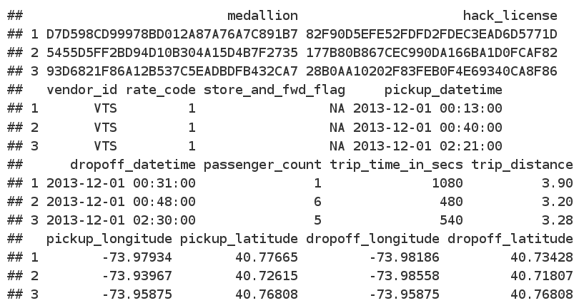
Dataset Refresher - The 2013 NYCTaxi Data Data wrangling, manipulations, modeling, and evaluation
The data used for this exercise is the public NYC Taxi Trip and Fare data-set (2013, December, ~4 Gb, ~13 million rows) available from: http://www.andresmh.com/nyctaxitrips
Notes:
Cortana Intelligence delivers an end-to-end platform with an integrated and comprehensive set of tools and services to help you build intelligent applications that let you easily take advantage of Advanced Analytics and intelligence capabilities.
First, Cortana Intelligence provides services to bring data in, so that you can analyze it. It provides information management capabilities like Azure Data Factory so that you can pull data from any source (relational DB like SQL or non-relational ones like your Hadoop cluster) in an automated and scheduled way, while performing the necessary data transforms (like setting certain data columns as dates vs. currency etc). Think ETL (Extract, Transform, Load) in the cloud. Event Hubs does the same for IoT type ingestion of data that streams in from lots of end points.
The data brought in then can be persisted in flexible big data storage services like Data Lake Store and Azure SQL Data Warehouse.
You can then use a wide range of analytics services from Machine Learning to Azure Data Lake Analytics to Azure HDInsight to Azure Stream Analytics to analyze the data stored in the big data storage. This means you can create analytics services and models specific to your business need (say real time demand forecasting).
The resultant analytics services and models created by taking these steps can then be surfaced as interactive dashboards and visualizations via Power BI.
These same analytics services and models created can also be integrated into various different UI (web apps or mobile apps or rich client apps), or with Cortana, so end users can naturally interact with them via speech etc., and so that end users can get proactively be notified by Cortana if the analytics model finds a new anomaly (unusual growth in certain product purchases- in the case of real time demand forecasting example given above) or whatever deserves the attention of the business users. Similar integration can occur with Cognitive Services or Bot Framework based applications.
At a high level though, Cortana Intelligence capabilities are in three main areas: data, analytics and intelligence.
<Transition>: We’re going to dive into each one, starting with data.

Slide 8
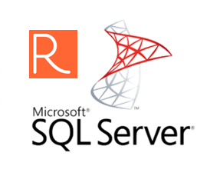
Demo Scenario
SQL Server R Services: -
Dev
Train
Test
Deploy
Score
CREATE LOGIN [<YourDSVMNameHere>\SQLRUserGroup] FROM WINDOWS
Notes:
Cortana Intelligence delivers an end-to-end platform with an integrated and comprehensive set of tools and services to help you build intelligent applications that let you easily take advantage of Advanced Analytics and intelligence capabilities.
First, Cortana Intelligence provides services to bring data in, so that you can analyze it. It provides information management capabilities like Azure Data Factory so that you can pull data from any source (relational DB like SQL or non-relational ones like your Hadoop cluster) in an automated and scheduled way, while performing the necessary data transforms (like setting certain data columns as dates vs. currency etc). Think ETL (Extract, Transform, Load) in the cloud. Event Hubs does the same for IoT type ingestion of data that streams in from lots of end points.
The data brought in then can be persisted in flexible big data storage services like Data Lake Store and Azure SQL Data Warehouse.
You can then use a wide range of analytics services from Machine Learning to Azure Data Lake Analytics to Azure HDInsight to Azure Stream Analytics to analyze the data stored in the big data storage. This means you can create analytics services and models specific to your business need (say real time demand forecasting).
The resultant analytics services and models created by taking these steps can then be surfaced as interactive dashboards and visualizations via Power BI.
These same analytics services and models created can also be integrated into various different UI (web apps or mobile apps or rich client apps), or with Cortana, so end users can naturally interact with them via speech etc., and so that end users can get proactively be notified by Cortana if the analytics model finds a new anomaly (unusual growth in certain product purchases- in the case of real time demand forecasting example given above) or whatever deserves the attention of the business users. Similar integration can occur with Cognitive Services or Bot Framework based applications.
At a high level though, Cortana Intelligence capabilities are in three main areas: data, analytics and intelligence.
<Transition>: We’re going to dive into each one, starting with data.

Slide 9
Demo Scenario
Using the Local Spark instance on the DSVM for Dev & Test
Notes:
Cortana Intelligence delivers an end-to-end platform with an integrated and comprehensive set of tools and services to help you build intelligent applications that let you easily take advantage of Advanced Analytics and intelligence capabilities.
First, Cortana Intelligence provides services to bring data in, so that you can analyze it. It provides information management capabilities like Azure Data Factory so that you can pull data from any source (relational DB like SQL or non-relational ones like your Hadoop cluster) in an automated and scheduled way, while performing the necessary data transforms (like setting certain data columns as dates vs. currency etc). Think ETL (Extract, Transform, Load) in the cloud. Event Hubs does the same for IoT type ingestion of data that streams in from lots of end points.
The data brought in then can be persisted in flexible big data storage services like Data Lake Store and Azure SQL Data Warehouse.
You can then use a wide range of analytics services from Machine Learning to Azure Data Lake Analytics to Azure HDInsight to Azure Stream Analytics to analyze the data stored in the big data storage. This means you can create analytics services and models specific to your business need (say real time demand forecasting).
The resultant analytics services and models created by taking these steps can then be surfaced as interactive dashboards and visualizations via Power BI.
These same analytics services and models created can also be integrated into various different UI (web apps or mobile apps or rich client apps), or with Cortana, so end users can naturally interact with them via speech etc., and so that end users can get proactively be notified by Cortana if the analytics model finds a new anomaly (unusual growth in certain product purchases- in the case of real time demand forecasting example given above) or whatever deserves the attention of the business users. Similar integration can occur with Cognitive Services or Bot Framework based applications.
At a high level though, Cortana Intelligence capabilities are in three main areas: data, analytics and intelligence.
<Transition>: We’re going to dive into each one, starting with data.

Slide 10


Using the Local Spark instance on the Linux DSVM with 2013 NYCTaxi Data Data wrangling, manipulations, modeling, and evaluation
Easily deployed/scaled interchangeably via YARN
Local Spark on the DSVM
Head and Worker Roles handled and optimized on the box by the Spark Local Process
Spark Cluster on HDInsight
Notes:
Cortana Intelligence delivers an end-to-end platform with an integrated and comprehensive set of tools and services to help you build intelligent applications that let you easily take advantage of Advanced Analytics and intelligence capabilities.
First, Cortana Intelligence provides services to bring data in, so that you can analyze it. It provides information management capabilities like Azure Data Factory so that you can pull data from any source (relational DB like SQL or non-relational ones like your Hadoop cluster) in an automated and scheduled way, while performing the necessary data transforms (like setting certain data columns as dates vs. currency etc). Think ETL (Extract, Transform, Load) in the cloud. Event Hubs does the same for IoT type ingestion of data that streams in from lots of end points.
The data brought in then can be persisted in flexible big data storage services like Data Lake Store and Azure SQL Data Warehouse.
You can then use a wide range of analytics services from Machine Learning to Azure Data Lake Analytics to Azure HDInsight to Azure Stream Analytics to analyze the data stored in the big data storage. This means you can create analytics services and models specific to your business need (say real time demand forecasting).
The resultant analytics services and models created by taking these steps can then be surfaced as interactive dashboards and visualizations via Power BI.
These same analytics services and models created can also be integrated into various different UI (web apps or mobile apps or rich client apps), or with Cortana, so end users can naturally interact with them via speech etc., and so that end users can get proactively be notified by Cortana if the analytics model finds a new anomaly (unusual growth in certain product purchases- in the case of real time demand forecasting example given above) or whatever deserves the attention of the business users. Similar integration can occur with Cognitive Services or Bot Framework based applications.
At a high level though, Cortana Intelligence capabilities are in three main areas: data, analytics and intelligence.
<Transition>: We’re going to dive into each one, starting with data.

Slide 11
Using SparkR on a Local Spark instance with 2013 NYCTaxi Data Data wrangling, manipulations, modeling, and evaluation
Two sets of files
trip_data CSVs contain trip details
trip_fare CSVs contain details of fare paid
Unique key to join trip_data and trip_fare: medallion, hack_licence, and pickup_datetime
Notes:
Cortana Intelligence delivers an end-to-end platform with an integrated and comprehensive set of tools and services to help you build intelligent applications that let you easily take advantage of Advanced Analytics and intelligence capabilities.
First, Cortana Intelligence provides services to bring data in, so that you can analyze it. It provides information management capabilities like Azure Data Factory so that you can pull data from any source (relational DB like SQL or non-relational ones like your Hadoop cluster) in an automated and scheduled way, while performing the necessary data transforms (like setting certain data columns as dates vs. currency etc). Think ETL (Extract, Transform, Load) in the cloud. Event Hubs does the same for IoT type ingestion of data that streams in from lots of end points.
The data brought in then can be persisted in flexible big data storage services like Data Lake Store and Azure SQL Data Warehouse.
You can then use a wide range of analytics services from Machine Learning to Azure Data Lake Analytics to Azure HDInsight to Azure Stream Analytics to analyze the data stored in the big data storage. This means you can create analytics services and models specific to your business need (say real time demand forecasting).
The resultant analytics services and models created by taking these steps can then be surfaced as interactive dashboards and visualizations via Power BI.
These same analytics services and models created can also be integrated into various different UI (web apps or mobile apps or rich client apps), or with Cortana, so end users can naturally interact with them via speech etc., and so that end users can get proactively be notified by Cortana if the analytics model finds a new anomaly (unusual growth in certain product purchases- in the case of real time demand forecasting example given above) or whatever deserves the attention of the business users. Similar integration can occur with Cognitive Services or Bot Framework based applications.
At a high level though, Cortana Intelligence capabilities are in three main areas: data, analytics and intelligence.
<Transition>: We’re going to dive into each one, starting with data.

Slide 12
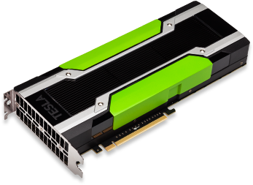
Demo Scenario
Training and Deploying Deep Learning Models Using the ‘Deep Learning Toolkit for the DSVM’ on GPU based Azure VMs
Notes:
Cortana Intelligence delivers an end-to-end platform with an integrated and comprehensive set of tools and services to help you build intelligent applications that let you easily take advantage of Advanced Analytics and intelligence capabilities.
First, Cortana Intelligence provides services to bring data in, so that you can analyze it. It provides information management capabilities like Azure Data Factory so that you can pull data from any source (relational DB like SQL or non-relational ones like your Hadoop cluster) in an automated and scheduled way, while performing the necessary data transforms (like setting certain data columns as dates vs. currency etc). Think ETL (Extract, Transform, Load) in the cloud. Event Hubs does the same for IoT type ingestion of data that streams in from lots of end points.
The data brought in then can be persisted in flexible big data storage services like Data Lake Store and Azure SQL Data Warehouse.
You can then use a wide range of analytics services from Machine Learning to Azure Data Lake Analytics to Azure HDInsight to Azure Stream Analytics to analyze the data stored in the big data storage. This means you can create analytics services and models specific to your business need (say real time demand forecasting).
The resultant analytics services and models created by taking these steps can then be surfaced as interactive dashboards and visualizations via Power BI.
These same analytics services and models created can also be integrated into various different UI (web apps or mobile apps or rich client apps), or with Cortana, so end users can naturally interact with them via speech etc., and so that end users can get proactively be notified by Cortana if the analytics model finds a new anomaly (unusual growth in certain product purchases- in the case of real time demand forecasting example given above) or whatever deserves the attention of the business users. Similar integration can occur with Cognitive Services or Bot Framework based applications.
At a high level though, Cortana Intelligence capabilities are in three main areas: data, analytics and intelligence.
<Transition>: We’re going to dive into each one, starting with data.

Slide 13
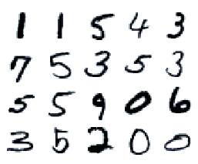
MNIST Feed Forward Network - Using CNTK (Microsoft Cognitive Toolkit)
The MNIST database (Mixed National Institute of Standards and Technology database) is a large database of handwritten digits that is commonly used for training various image processing systems.
http://yann.lecun.com/exdb/mnist/
Notes:
Cortana Intelligence delivers an end-to-end platform with an integrated and comprehensive set of tools and services to help you build intelligent applications that let you easily take advantage of Advanced Analytics and intelligence capabilities.
First, Cortana Intelligence provides services to bring data in, so that you can analyze it. It provides information management capabilities like Azure Data Factory so that you can pull data from any source (relational DB like SQL or non-relational ones like your Hadoop cluster) in an automated and scheduled way, while performing the necessary data transforms (like setting certain data columns as dates vs. currency etc). Think ETL (Extract, Transform, Load) in the cloud. Event Hubs does the same for IoT type ingestion of data that streams in from lots of end points.
The data brought in then can be persisted in flexible big data storage services like Data Lake Store and Azure SQL Data Warehouse.
You can then use a wide range of analytics services from Machine Learning to Azure Data Lake Analytics to Azure HDInsight to Azure Stream Analytics to analyze the data stored in the big data storage. This means you can create analytics services and models specific to your business need (say real time demand forecasting).
The resultant analytics services and models created by taking these steps can then be surfaced as interactive dashboards and visualizations via Power BI.
These same analytics services and models created can also be integrated into various different UI (web apps or mobile apps or rich client apps), or with Cortana, so end users can naturally interact with them via speech etc., and so that end users can get proactively be notified by Cortana if the analytics model finds a new anomaly (unusual growth in certain product purchases- in the case of real time demand forecasting example given above) or whatever deserves the attention of the business users. Similar integration can occur with Cognitive Services or Bot Framework based applications.
At a high level though, Cortana Intelligence capabilities are in three main areas: data, analytics and intelligence.
<Transition>: We’re going to dive into each one, starting with data.

Slide 14
The Deep Learning toolkit for DSVM Click Here
Physical Card = 2 x NVidia TESLA K80 GPUs
The Toolkit deploys on NC class Azure VMs with GPUs
Great for Deep Learning workloads
Current NC Class VM SKU Configurations:
x 1 K80 GPU - 1/2 Physical Card - 12 GB GDDR5 VRAM
x 2 K80 GPUs - 1 Physical Card - 24 GB GDDR5 VRAM
x 4 K80 GPUs - 2 Physical Cards - 48 GB GDDR5 VRAM
Notes:
Cortana Intelligence delivers an end-to-end platform with an integrated and comprehensive set of tools and services to help you build intelligent applications that let you easily take advantage of Advanced Analytics and intelligence capabilities.
First, Cortana Intelligence provides services to bring data in, so that you can analyze it. It provides information management capabilities like Azure Data Factory so that you can pull data from any source (relational DB like SQL or non-relational ones like your Hadoop cluster) in an automated and scheduled way, while performing the necessary data transforms (like setting certain data columns as dates vs. currency etc). Think ETL (Extract, Transform, Load) in the cloud. Event Hubs does the same for IoT type ingestion of data that streams in from lots of end points.
The data brought in then can be persisted in flexible big data storage services like Data Lake Store and Azure SQL Data Warehouse.
You can then use a wide range of analytics services from Machine Learning to Azure Data Lake Analytics to Azure HDInsight to Azure Stream Analytics to analyze the data stored in the big data storage. This means you can create analytics services and models specific to your business need (say real time demand forecasting).
The resultant analytics services and models created by taking these steps can then be surfaced as interactive dashboards and visualizations via Power BI.
These same analytics services and models created can also be integrated into various different UI (web apps or mobile apps or rich client apps), or with Cortana, so end users can naturally interact with them via speech etc., and so that end users can get proactively be notified by Cortana if the analytics model finds a new anomaly (unusual growth in certain product purchases- in the case of real time demand forecasting example given above) or whatever deserves the attention of the business users. Similar integration can occur with Cognitive Services or Bot Framework based applications.
At a high level though, Cortana Intelligence capabilities are in three main areas: data, analytics and intelligence.
<Transition>: We’re going to dive into each one, starting with data.

Slide 15


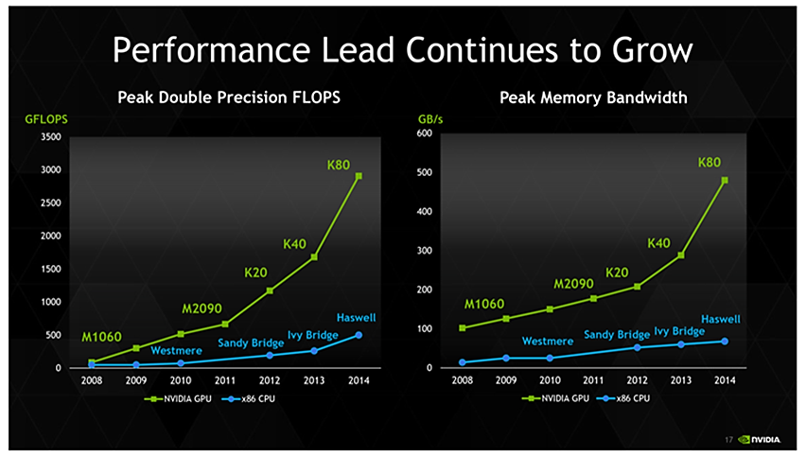
Deep Learning Toolkit
for the Data Science Virtual Machine (DSVM)
GPU based Parallelization provides orders of magnitude increase in Performance when it comes to Deep Learning

Slide 16
MNIST Feed Forward Network - Using CNTK (Microsoft Cognitive Toolkit)
1 1 5 4 3
7 5 3 5 3
5 5 9 0 6
3 5 2 0 0
Notes:
Cortana Intelligence delivers an end-to-end platform with an integrated and comprehensive set of tools and services to help you build intelligent applications that let you easily take advantage of Advanced Analytics and intelligence capabilities.
First, Cortana Intelligence provides services to bring data in, so that you can analyze it. It provides information management capabilities like Azure Data Factory so that you can pull data from any source (relational DB like SQL or non-relational ones like your Hadoop cluster) in an automated and scheduled way, while performing the necessary data transforms (like setting certain data columns as dates vs. currency etc). Think ETL (Extract, Transform, Load) in the cloud. Event Hubs does the same for IoT type ingestion of data that streams in from lots of end points.
The data brought in then can be persisted in flexible big data storage services like Data Lake Store and Azure SQL Data Warehouse.
You can then use a wide range of analytics services from Machine Learning to Azure Data Lake Analytics to Azure HDInsight to Azure Stream Analytics to analyze the data stored in the big data storage. This means you can create analytics services and models specific to your business need (say real time demand forecasting).
The resultant analytics services and models created by taking these steps can then be surfaced as interactive dashboards and visualizations via Power BI.
These same analytics services and models created can also be integrated into various different UI (web apps or mobile apps or rich client apps), or with Cortana, so end users can naturally interact with them via speech etc., and so that end users can get proactively be notified by Cortana if the analytics model finds a new anomaly (unusual growth in certain product purchases- in the case of real time demand forecasting example given above) or whatever deserves the attention of the business users. Similar integration can occur with Cognitive Services or Bot Framework based applications.
At a high level though, Cortana Intelligence capabilities are in three main areas: data, analytics and intelligence.
<Transition>: We’re going to dive into each one, starting with data.

Slide 17
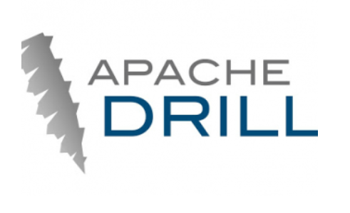
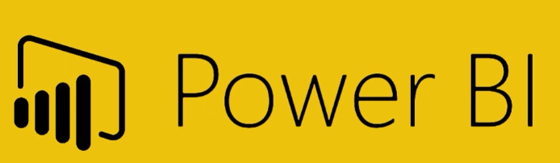
Demo Scenario
Querying and wrangling across platforms using Apache Drill
Special Appearance by
Notes:
Cortana Intelligence delivers an end-to-end platform with an integrated and comprehensive set of tools and services to help you build intelligent applications that let you easily take advantage of Advanced Analytics and intelligence capabilities.
First, Cortana Intelligence provides services to bring data in, so that you can analyze it. It provides information management capabilities like Azure Data Factory so that you can pull data from any source (relational DB like SQL or non-relational ones like your Hadoop cluster) in an automated and scheduled way, while performing the necessary data transforms (like setting certain data columns as dates vs. currency etc). Think ETL (Extract, Transform, Load) in the cloud. Event Hubs does the same for IoT type ingestion of data that streams in from lots of end points.
The data brought in then can be persisted in flexible big data storage services like Data Lake Store and Azure SQL Data Warehouse.
You can then use a wide range of analytics services from Machine Learning to Azure Data Lake Analytics to Azure HDInsight to Azure Stream Analytics to analyze the data stored in the big data storage. This means you can create analytics services and models specific to your business need (say real time demand forecasting).
The resultant analytics services and models created by taking these steps can then be surfaced as interactive dashboards and visualizations via Power BI.
These same analytics services and models created can also be integrated into various different UI (web apps or mobile apps or rich client apps), or with Cortana, so end users can naturally interact with them via speech etc., and so that end users can get proactively be notified by Cortana if the analytics model finds a new anomaly (unusual growth in certain product purchases- in the case of real time demand forecasting example given above) or whatever deserves the attention of the business users. Similar integration can occur with Cognitive Services or Bot Framework based applications.
At a high level though, Cortana Intelligence capabilities are in three main areas: data, analytics and intelligence.
<Transition>: We’re going to dive into each one, starting with data.

Slide 18
Exploring the 2013 NYCTaxi Data using Apache DRILL: Data wrangling, manipulations, modeling, and evaluation
Two sets of files
trip_data CSVs contain trip details
trip_fare CSVs contain details of fare paid
Unique key to join trip_data and trip_fare: medallion, hack_licence, and pickup_datetime
Notes:
Cortana Intelligence delivers an end-to-end platform with an integrated and comprehensive set of tools and services to help you build intelligent applications that let you easily take advantage of Advanced Analytics and intelligence capabilities.
First, Cortana Intelligence provides services to bring data in, so that you can analyze it. It provides information management capabilities like Azure Data Factory so that you can pull data from any source (relational DB like SQL or non-relational ones like your Hadoop cluster) in an automated and scheduled way, while performing the necessary data transforms (like setting certain data columns as dates vs. currency etc). Think ETL (Extract, Transform, Load) in the cloud. Event Hubs does the same for IoT type ingestion of data that streams in from lots of end points.
The data brought in then can be persisted in flexible big data storage services like Data Lake Store and Azure SQL Data Warehouse.
You can then use a wide range of analytics services from Machine Learning to Azure Data Lake Analytics to Azure HDInsight to Azure Stream Analytics to analyze the data stored in the big data storage. This means you can create analytics services and models specific to your business need (say real time demand forecasting).
The resultant analytics services and models created by taking these steps can then be surfaced as interactive dashboards and visualizations via Power BI.
These same analytics services and models created can also be integrated into various different UI (web apps or mobile apps or rich client apps), or with Cortana, so end users can naturally interact with them via speech etc., and so that end users can get proactively be notified by Cortana if the analytics model finds a new anomaly (unusual growth in certain product purchases- in the case of real time demand forecasting example given above) or whatever deserves the attention of the business users. Similar integration can occur with Cognitive Services or Bot Framework based applications.
At a high level though, Cortana Intelligence capabilities are in three main areas: data, analytics and intelligence.
<Transition>: We’re going to dive into each one, starting with data.

Slide 19
Roadmap
Windows Server 2016 based DSVM Offering
Containerized Workloads
Windows 10 style Desktop Experience
Excel (Office 365) – Pre-installed – Needs BYO ProPlus Subscription
Ubuntu Based Deep Learning DSVM
Investment into other categories
IOT
Cognitive Computing
Notes:
Cortana Intelligence delivers an end-to-end platform with an integrated and comprehensive set of tools and services to help you build intelligent applications that let you easily take advantage of Advanced Analytics and intelligence capabilities.
First, Cortana Intelligence provides services to bring data in, so that you can analyze it. It provides information management capabilities like Azure Data Factory so that you can pull data from any source (relational DB like SQL or non-relational ones like your Hadoop cluster) in an automated and scheduled way, while performing the necessary data transforms (like setting certain data columns as dates vs. currency etc). Think ETL (Extract, Transform, Load) in the cloud. Event Hubs does the same for IoT type ingestion of data that streams in from lots of end points.
The data brought in then can be persisted in flexible big data storage services like Data Lake Store and Azure SQL Data Warehouse.
You can then use a wide range of analytics services from Machine Learning to Azure Data Lake Analytics to Azure HDInsight to Azure Stream Analytics to analyze the data stored in the big data storage. This means you can create analytics services and models specific to your business need (say real time demand forecasting).
The resultant analytics services and models created by taking these steps can then be surfaced as interactive dashboards and visualizations via Power BI.
These same analytics services and models created can also be integrated into various different UI (web apps or mobile apps or rich client apps), or with Cortana, so end users can naturally interact with them via speech etc., and so that end users can get proactively be notified by Cortana if the analytics model finds a new anomaly (unusual growth in certain product purchases- in the case of real time demand forecasting example given above) or whatever deserves the attention of the business users. Similar integration can occur with Cognitive Services or Bot Framework based applications.
At a high level though, Cortana Intelligence capabilities are in three main areas: data, analytics and intelligence.
<Transition>: We’re going to dive into each one, starting with data.

Slide 20
Summary
Introduction to the Data Science Virtual Machines in Azure
Scenario Walkthroughs:
SQL Server R Services: - Dev>Train>Test>Deploy>Score
Using the Local Spark instance on the DSVM for Dev & Test
Training and Deploying Deep Learning Models Using the ‘Deep Learning Toolkit for the DSVM’ on GPU based Azure VMs
Briefly Querying and wrangling across platforms
Roadmap
Q and A
This session familiarizes attendees to some popular scenarios enabled by the DSVM and the included tools.
This is not a general training module for Data Science. Please visit http://learnanalytics.microsoft.com
Notes:
Cortana Intelligence delivers an end-to-end platform with an integrated and comprehensive set of tools and services to help you build intelligent applications that let you easily take advantage of Advanced Analytics and intelligence capabilities.
First, Cortana Intelligence provides services to bring data in, so that you can analyze it. It provides information management capabilities like Azure Data Factory so that you can pull data from any source (relational DB like SQL or non-relational ones like your Hadoop cluster) in an automated and scheduled way, while performing the necessary data transforms (like setting certain data columns as dates vs. currency etc). Think ETL (Extract, Transform, Load) in the cloud. Event Hubs does the same for IoT type ingestion of data that streams in from lots of end points.
The data brought in then can be persisted in flexible big data storage services like Data Lake Store and Azure SQL Data Warehouse.
You can then use a wide range of analytics services from Machine Learning to Azure Data Lake Analytics to Azure HDInsight to Azure Stream Analytics to analyze the data stored in the big data storage. This means you can create analytics services and models specific to your business need (say real time demand forecasting).
The resultant analytics services and models created by taking these steps can then be surfaced as interactive dashboards and visualizations via Power BI.
These same analytics services and models created can also be integrated into various different UI (web apps or mobile apps or rich client apps), or with Cortana, so end users can naturally interact with them via speech etc., and so that end users can get proactively be notified by Cortana if the analytics model finds a new anomaly (unusual growth in certain product purchases- in the case of real time demand forecasting example given above) or whatever deserves the attention of the business users. Similar integration can occur with Cognitive Services or Bot Framework based applications.
At a high level though, Cortana Intelligence capabilities are in three main areas: data, analytics and intelligence.
<Transition>: We’re going to dive into each one, starting with data.

Slide 21
Useful Links
DSVM Forum - send questions, feedback and feature requests on the forum - http://aka.ms/dsvm/forum
DSVM Product Page – http://aka.ms/dsvm
DSVM Introductory DIY workshop – http://aka.ms/dsvm/workshop
2 Page Handout – http://aka.ms/dsvm/handout
Learn Analytics @ Microsoft – http://learnanalytics.microsoft.com
Notes:
Cortana Intelligence delivers an end-to-end platform with an integrated and comprehensive set of tools and services to help you build intelligent applications that let you easily take advantage of Advanced Analytics and intelligence capabilities.
First, Cortana Intelligence provides services to bring data in, so that you can analyze it. It provides information management capabilities like Azure Data Factory so that you can pull data from any source (relational DB like SQL or non-relational ones like your Hadoop cluster) in an automated and scheduled way, while performing the necessary data transforms (like setting certain data columns as dates vs. currency etc). Think ETL (Extract, Transform, Load) in the cloud. Event Hubs does the same for IoT type ingestion of data that streams in from lots of end points.
The data brought in then can be persisted in flexible big data storage services like Data Lake Store and Azure SQL Data Warehouse.
You can then use a wide range of analytics services from Machine Learning to Azure Data Lake Analytics to Azure HDInsight to Azure Stream Analytics to analyze the data stored in the big data storage. This means you can create analytics services and models specific to your business need (say real time demand forecasting).
The resultant analytics services and models created by taking these steps can then be surfaced as interactive dashboards and visualizations via Power BI.
These same analytics services and models created can also be integrated into various different UI (web apps or mobile apps or rich client apps), or with Cortana, so end users can naturally interact with them via speech etc., and so that end users can get proactively be notified by Cortana if the analytics model finds a new anomaly (unusual growth in certain product purchases- in the case of real time demand forecasting example given above) or whatever deserves the attention of the business users. Similar integration can occur with Cognitive Services or Bot Framework based applications.
At a high level though, Cortana Intelligence capabilities are in three main areas: data, analytics and intelligence.
<Transition>: We’re going to dive into each one, starting with data.

